Slide 1
Plant leaf recognition
Deep learning Project
2100030219
2100031154
2100031252

Slide 2
Abstract
This project explores deep learning (DL) for classifying plant leaves into different types. We preprocess a dataset of leaf images and compare CNNs and transfer learning for classification. Applying data augmentation and regularization improves model performance
About our Dataset
The plant leaf recognition dataset is a collection of images of plant leaves belonging to different plant species. In our project, we're working with a dataset containing 14 different types of leaves, organized into 38 folders with labels indicating healthy leaf, leaves with various types of spots(such as black spots, grey spots, etc.) including bacterial spots. From this dataset, we've selected 3 types of leaves for our project. Due to the dataset's size and our computers' processing limitations, we have opted to work with only 3 types of leaves from the dataset. Each image in the dataset typically includes a single leaf with a plain background, and the images are labeled with the corresponding plant species. . A dataset of 4503 images

Slide 3
Preprocessing of the dataset
Background Removal:
Use techniques such as thresholding, edge detection (e.g., Canny edge detection), or segmentation algorithms (e.g., GrabCut) to separate the leaf region from the background.
Once the leaf region is segmented, remove the background by replacing it with a uniform color or setting it to transparent.
Rescaling:
Resize the preprocessed images to a uniform size suitable for model input. Common sizes include 224x224 or 256x256 pixels for CNN-based models.
Maintain the aspect ratio to prevent distortion of the leaf's shape and features during rescaling.
Data Augmentation:
Apply various transformations to augment the dataset and increase its diversity:
Rotation: Rotate the images by a certain degree (e.g., randomly between -45° and 45°) to simulate different orientations.
Flipping: Flip the images horizontally or vertically to create mirror images.
Scaling: Scale the images by zooming in or out to simulate different distances from the camera.
Translation: Shift the images horizontally or vertically to simulate changes in position.
Shearing: Apply shearing transformations to the images to simulate skewing.
Adding Noise: Introduce random noise to the images to make the model more robust to noise in real-world

Slide 4


Total images count after preprocessing : 27,970
Data set size decreased from 7GB to 250MB

Slide 5
Sequential Model :
model = tf.keras.models.Sequential([
tf.keras.layers.Flatten(input_shape=(IMG_HEIGHT, IMG_WIDTH, 3)),
tf.keras.layers.Dense(512, activation='relu'),
tf.keras.layers.Dropout(0.5),
tf.keras.layers.Dense(256, activation='relu'),
tf.keras.layers.Dropout(0.5),
tf.keras.layers.Dense(NUM_CLASSES, activation='softmax')
])

Slide 6
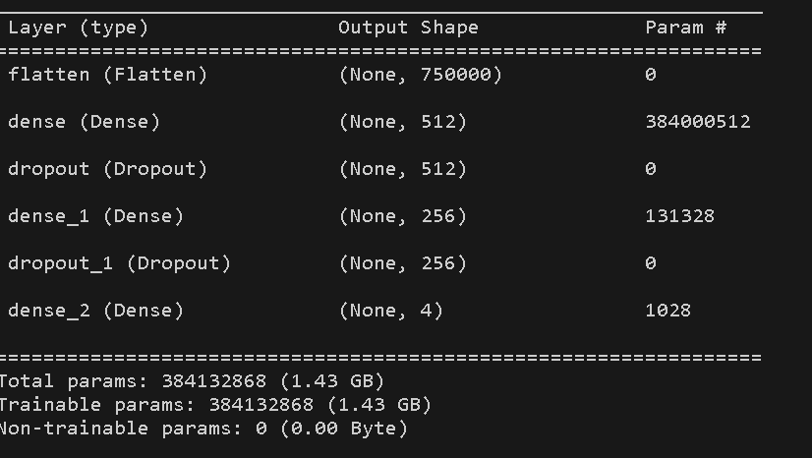
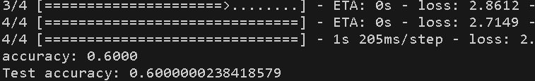
Sequential Model :

Slide 7
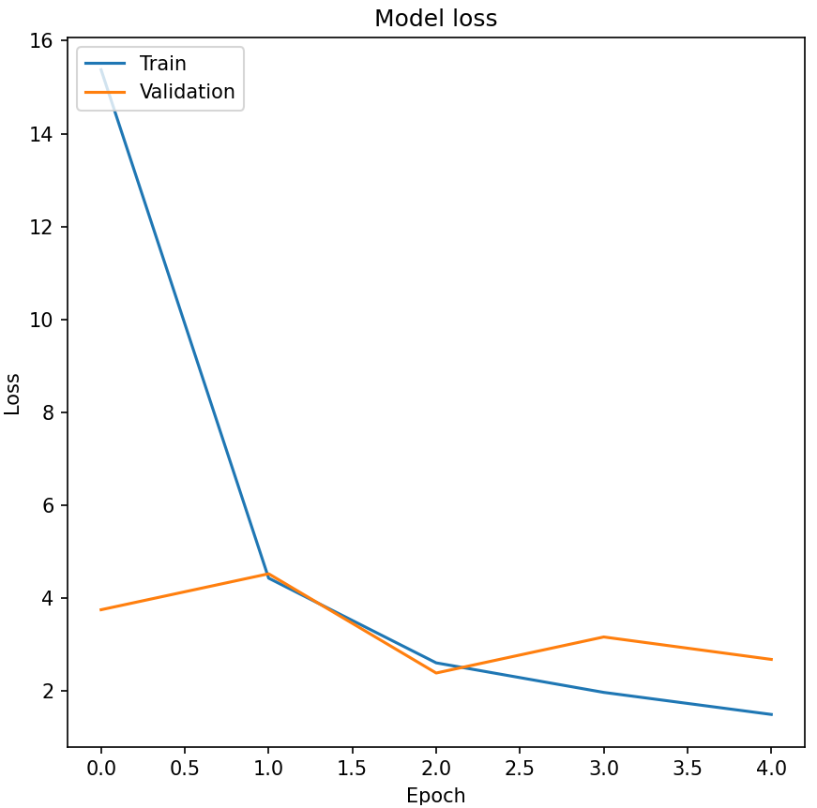
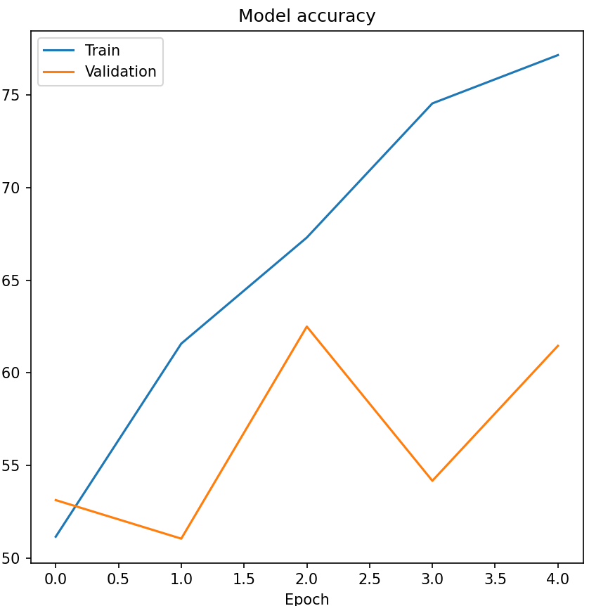
Sequential Model :

Slide 8
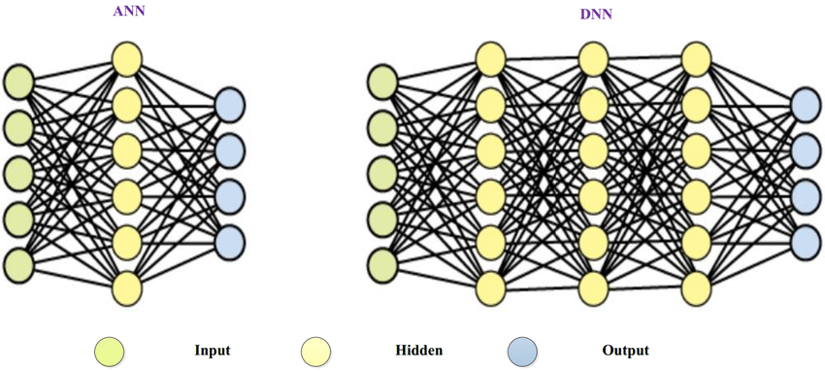
Sequential Model :

Slide 9
Sequential Model Optimizer (ADAM,SGD,RMSPROP):
Stochastic Gradient Descent (SGD):
Update Rule: SGD computes gradients based on a selecting one randomly of training data (hence “stochastic”). It then updates the model parameters in the direction opposite to the gradient.
Learning Rate: The learning rate determines the step size for parameter updates.
Momentum: SGD with momentum helps accelerate convergence by considering past gradients.
Adam (Adaptive Moment Estimation):
Update Rule: Adam combines the benefits of both AdaGrad and RMSprop. It adapts the learning rate for each parameter individually and maintains moving averages of gradients and squared gradients.
Learning Rate: Adam dynamically adjusts the learning rate based on the past gradients.
Use Case: Adam is popular due to its robustness and efficiency.
RMSprop (Root Mean Square Propagation):
Update Rule: RMSprop divides the learning rate by an exponentially decaying average of squared gradients. It helps mitigate the diminishing learning rate problem.
Learning Rate: RMSprop adapts the learning rate based on the magnitude of gradients.
Use Case: RMSprop is effective for movement objectives.

Slide 10
def simple_ANN(self, input_shape=(128,128, 3), optimizer='sgd'): model = Sequential() model.add(Flatten(input_shape=input_shape)) model.add(Dense(128, activation="relu")) model.add(Dense(64, activation="relu")) model.add(Dense(3, activation="softmax"))
# Use softmax for multiclass classification model.compile(loss="categorical_crossentropy", optimizer=optimizer, metrics=["accuracy"]) return model

Slide 11
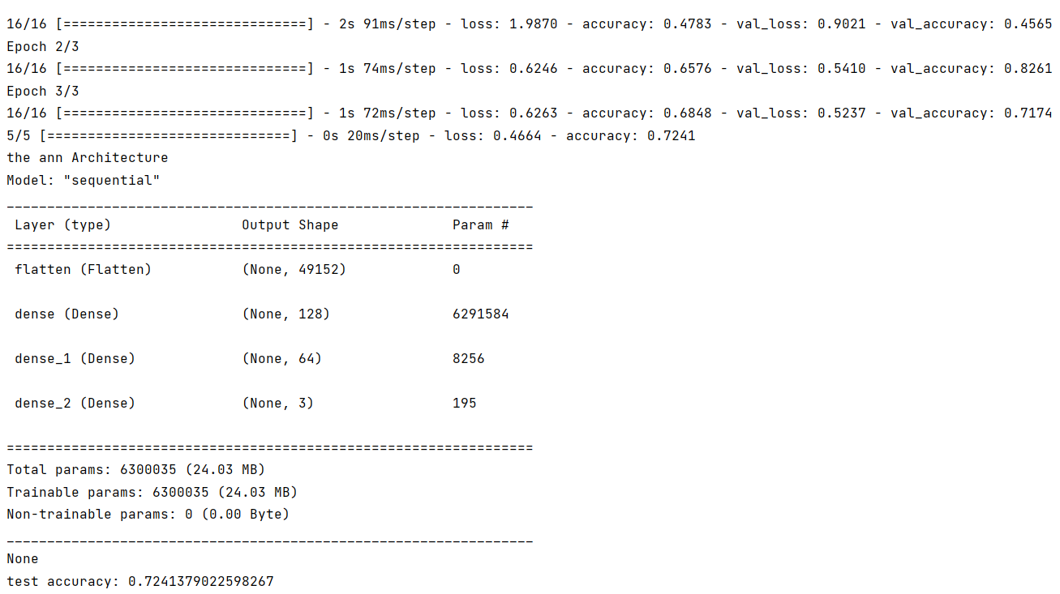
SGD Optimizer

Slide 12
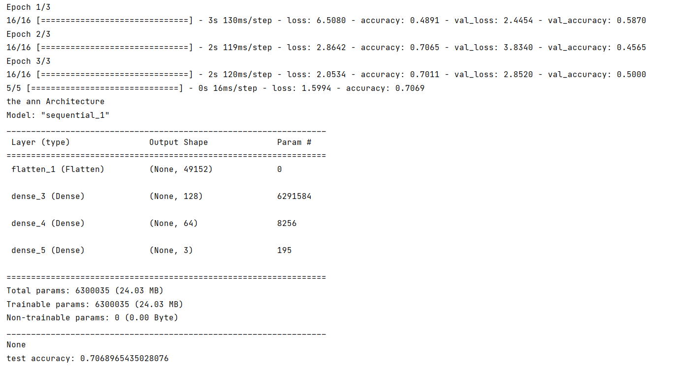
ADAM Optimizer

Slide 13
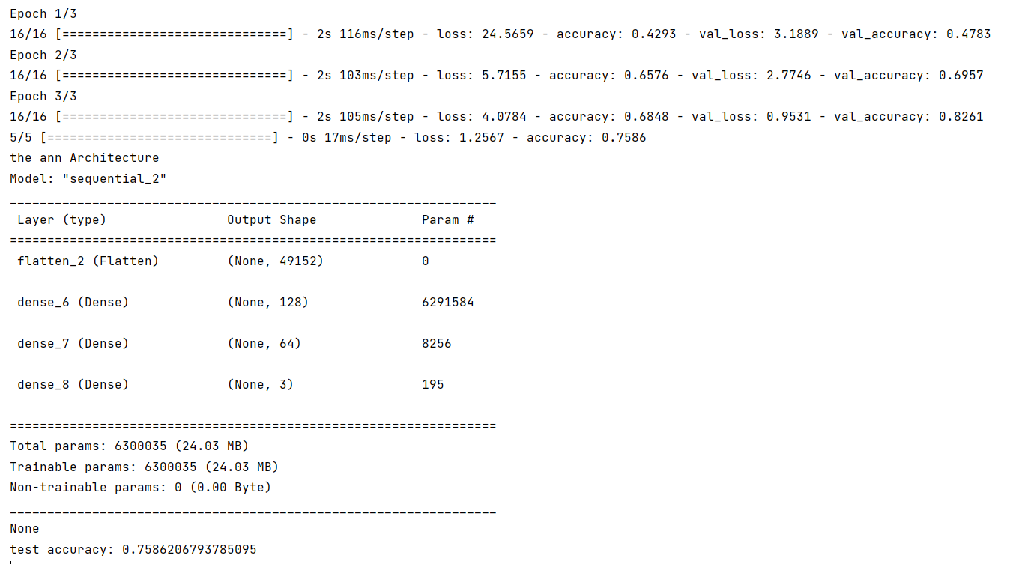
RMSPROP Optimizer

Slide 14
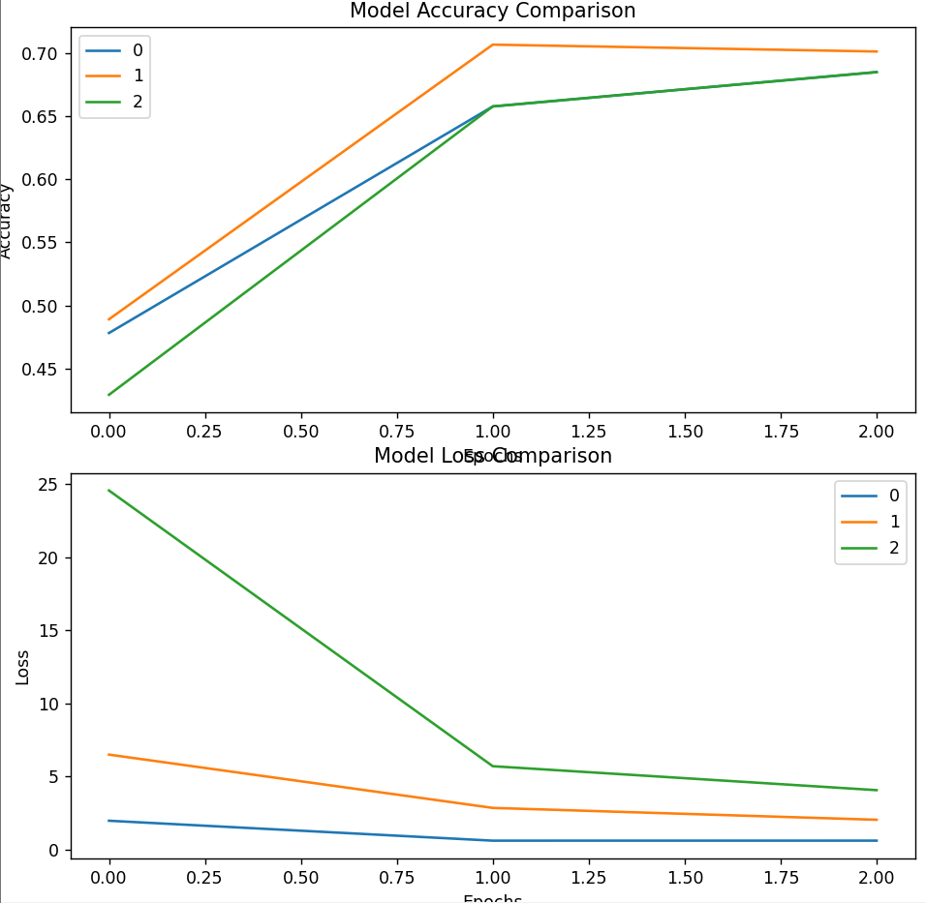
Compare of 3 Models

Slide 15
Sequential model to classify data in to multiple classes
# Define the model
model = Sequential([
Conv2D(32, (3, 3), activation='relu', input_shape=(img_height, img_width, 3)),
MaxPooling2D((2, 2)),
Conv2D(64, (3, 3), activation='relu'),
MaxPooling2D((2, 2)),
Conv2D(128, (3, 3), activation='relu'),
MaxPooling2D((2, 2)),
Flatten(),
Dense(128, activation='relu'),
Dense(num_classes, activation='softmax') # Using softmax for multi-class classification
])
# Compile the model
model.compile(optimizer='adam',
loss='categorical_crossentropy',
metrics=['accuracy'])

Slide 16
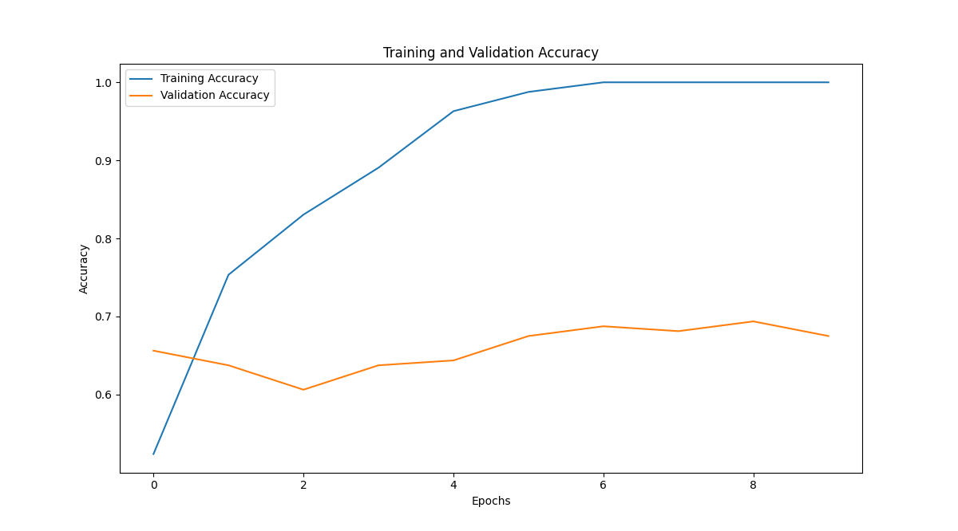
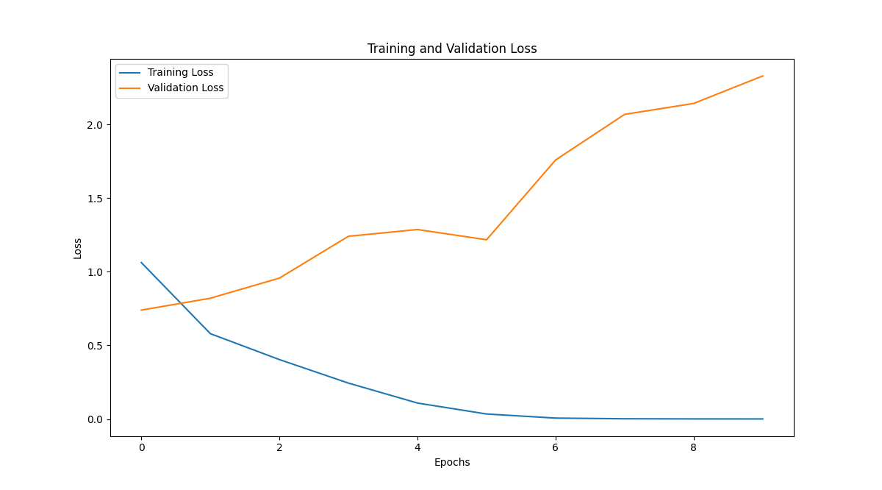
Sequential model to classify data in to multiple classes

Slide 17
CNN Model
CNN model is designed to classify images into predefined classes by extracting relevant features and mapping them to the corresponding labels.
We use CNN for image classification because CNNs automatically learn meaningful spatial features from images, which is crucial for accurate object recognition.
Here we have used
->Input Layer: Accepts raw image data (represented as matrices of pixel values).
->Convolutional Layers (Conv2D): These layers learn to extract relevant features from the input images. They use filters to detect patterns like edges and textures.
->MaxPooling Layers (MaxPooling2D): These layers downsample the feature maps, reducing their spatial dimensions.
->Flatten Layer: Converts the 2D feature maps into a 1D vector.
-> Dense Layers: Fully connected layers that learn to classify the features extracted by the previous layers.
->Output Layer: Produces class probabilities using the softmax activation function.

Slide 18
CNN Model
def cnn_model(self, input_shape=(128, 128, 3), num_classes=6, optimizer='sgd'): model = Sequential() model.add(Conv2D(32, (3, 3), activation='relu', input_shape=input_shape)) model.add(MaxPooling2D(2, 2)) model.add(Conv2D(64, (3, 3), activation='relu')) model.add(MaxPooling2D((2, 2))) model.add(Flatten()) model.add(Dense(128, activation="relu")) model.add(Dense(64, activation="relu")) model.add(Dense(num_classes, activation="softmax")) # Adjusted to match num_classes model.compile(optimizer='adam', loss='categorical_crossentropy', metrics=['accuracy']) return model

Slide 19
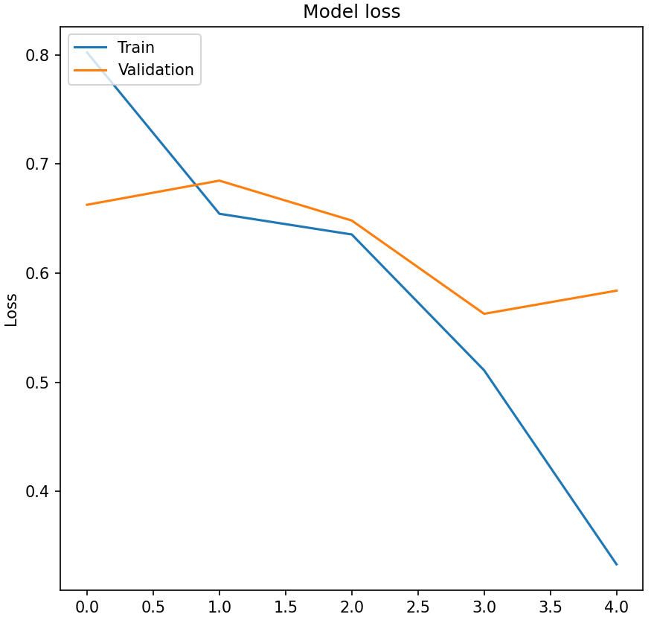
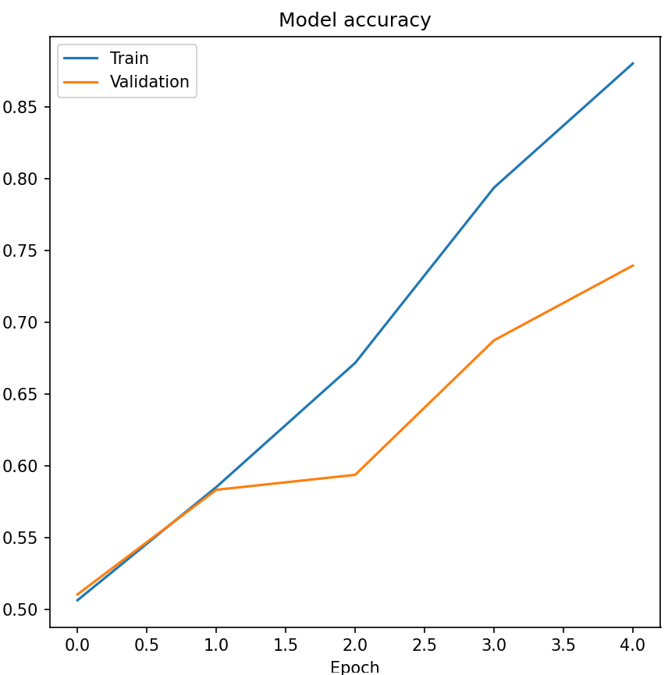
CNN Model

Slide 20
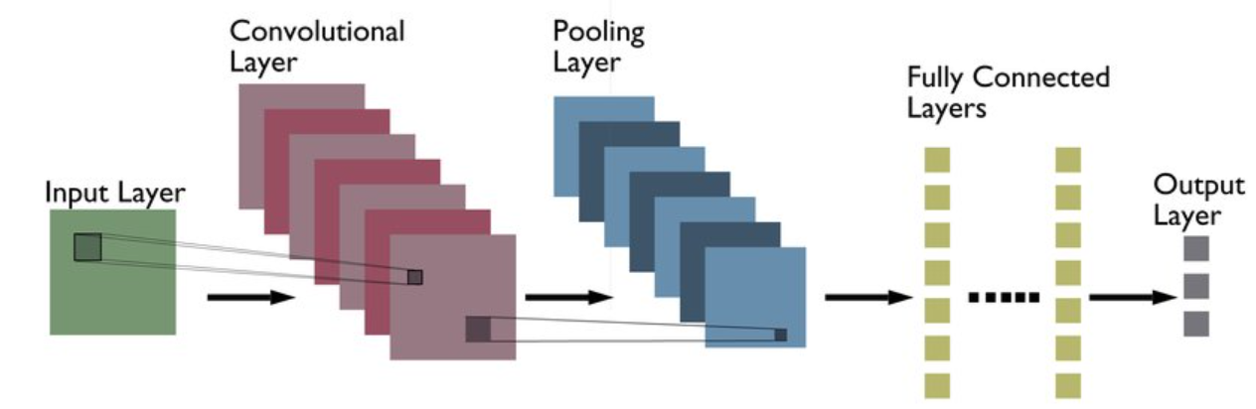
CNN Model

Slide 21
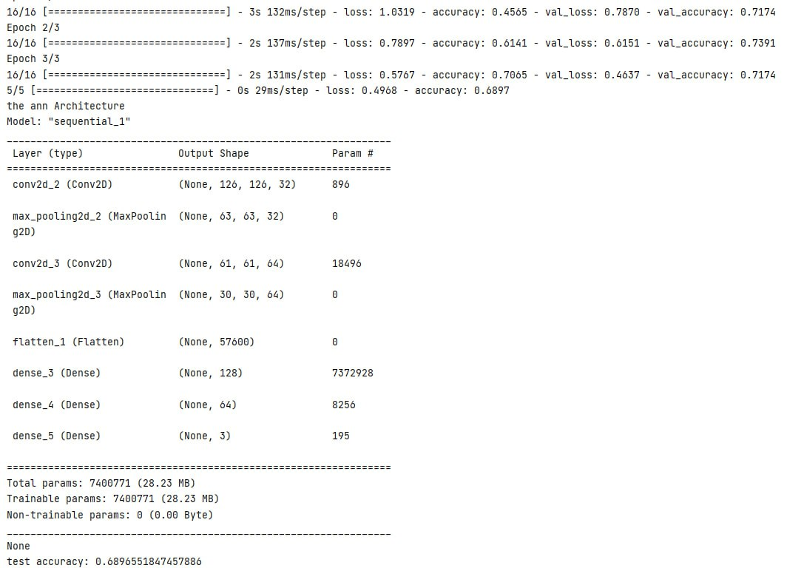
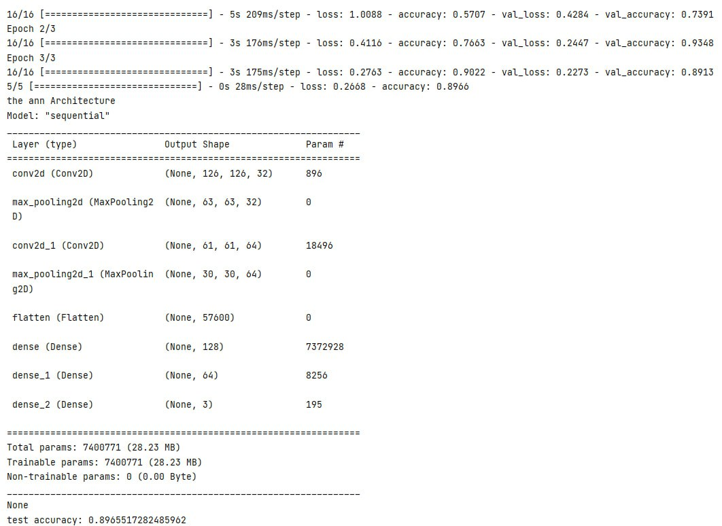
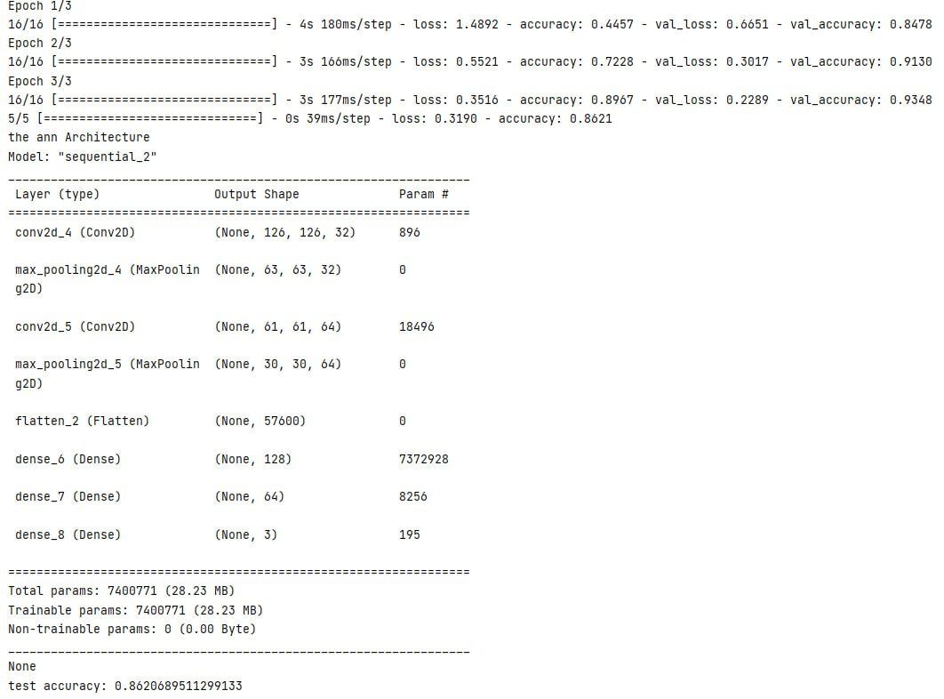
ADM
SGD
RMS PROP

Slide 22
Cnn model with regularizations
Batch Normalization (Batch Norm):
Batch Normalization is a powerful technique used to normalize the activations between layers of a neural network. Unlike traditional normalization applied to raw input data, Batch Norm operates within the network itself.
Purpose:
Speeds up training: By normalizing activations within mini-batches, Batch Norm allows for higher learning rates, which accelerates the learning process.
Regularization: It helps prevent overfitting by providing a form of regularization.
How It Works:
During training, Batch Norm computes the mean and standard deviation of activations within each mini-batch.
It then normalizes the activations using the mean and standard deviation.
The normalized activations are scaled and shifted using learnable parameters (gamma and beta).
During inference, Batch Norm uses the population statistics (accumulated during training) for normalization.
Dropout:
Dropout is a regularization technique that randomly drops out (sets to zero) a fraction of neurons during training.
Purpose:
Regularization: By preventing co-adaptation of neurons, dropout reduces overfitting.
Ensemble effect: It creates an ensemble of multiple sub-networks, improving generalization.
How It Works:
During training, each neuron has a probability (dropout rate) of being dropped out.
The dropped-out neurons do not contribute to forward or backward passes.
During interpretation, dropout is turned off, and all neurons are active.

Slide 23
Cnn model with regularizations
def cnn_add_regularize(self): model = Sequential() # convolutional layers model.add(Conv2D(32, (3, 3), activation='relu',input_shape=(128,128,3)))
model.add(BatchNormalization()) model.add(MaxPooling2D((2, 2))) model.add(Dropout(0.25)) model.add(Conv2D(64, (3, 3), activation='relu', kernel_regularizer=regularizers.l2(0.01))) model.add(BatchNormalization()) model.add(MaxPooling2D((2, 2))) model.add(Dropout(0.25)) # fully connected layer model.add(Flatten()) model.add(Dense(128, activation='relu')) model.add(Dense(64, activation='relu')) # output layer model.add(Dense(3, activation='softmax')) # compilation model.compile(loss="categorical_crossentropy", optimizer="sgd", metrics=["accuracy"]) return model

Slide 24
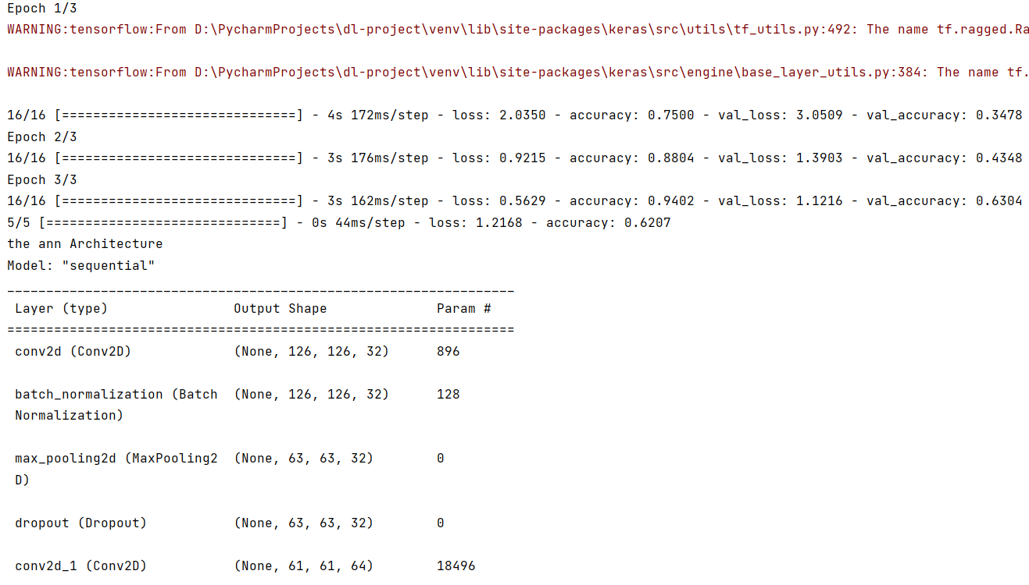
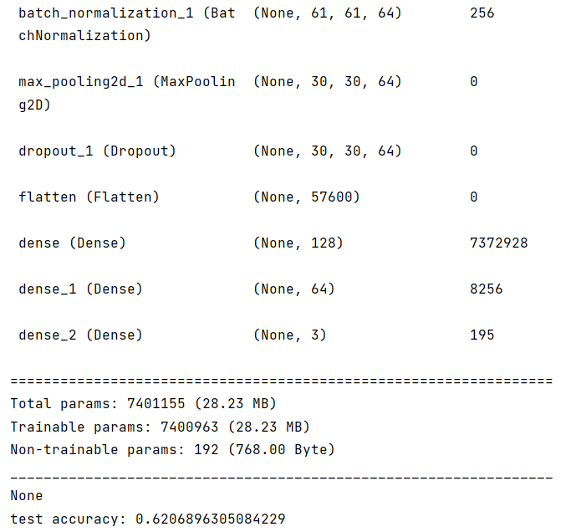

Slide 25
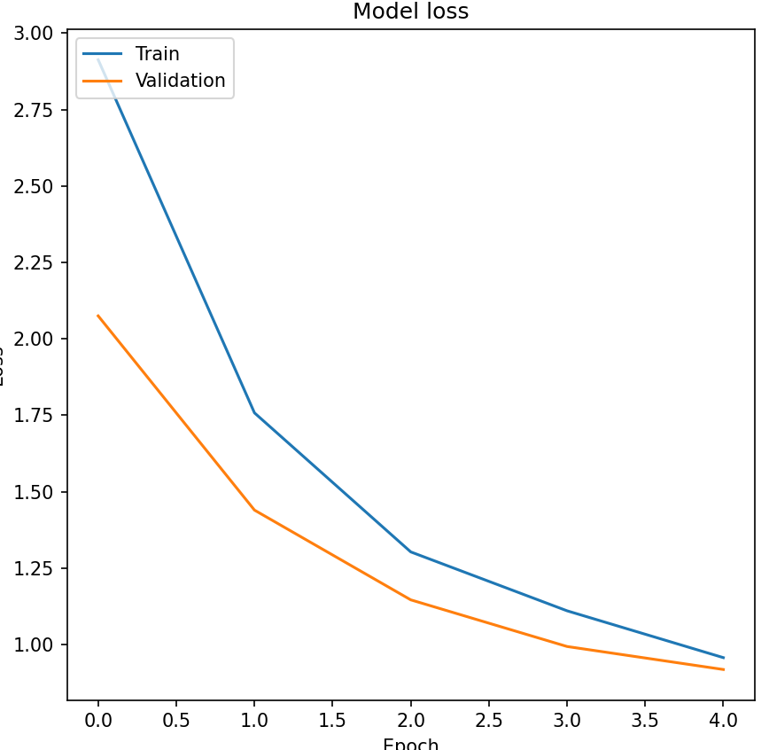
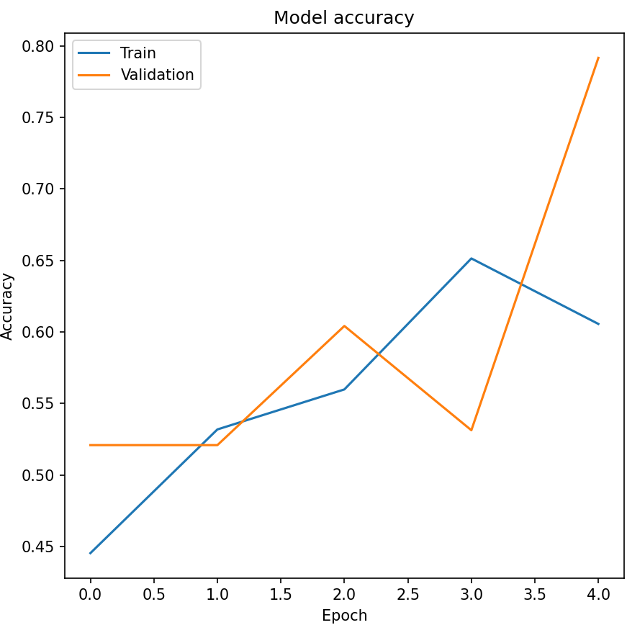
Cnn model with regularizations

Slide 26
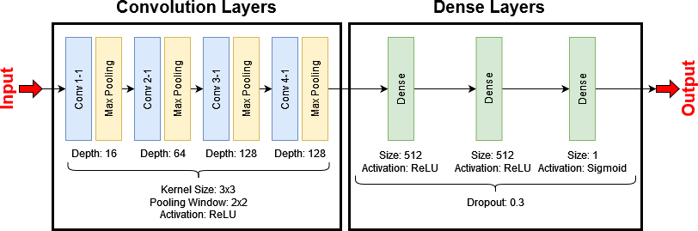
Cnn model with regularizations

Slide 27
VGG16
Understanding Transfer Learning:
Transfer learning involves taking a pre-trained model (like VGG16) and fine-tuning it on a new dataset.
Instead of training a model from scratch, we start with the knowledge already captured by the pre-trained model.
VGG16 was originally trained on the ImageNet dataset, which contains millions of labeled images across various categories.
VGG16 Architecture:
VGG16 is a deep convolutional neural network (CNN) with 16 weight layers.
It consists of 13 convolutional layers (with small 3x3 filters) followed by 3 fully connected layers.
The architecture is known for its simplicity and effectiveness.
Transfer Learning Steps:
Load Pre-trained VGG16 Model:
Download the pre-trained VGG16 model from Keras or any other source.
You can choose whether to include the top (fully connected) layers or not.
Freeze Convolutional Layers:
Freeze the weights of the convolutional layers (up to a certain layer).
These layers act as feature extractors.
Add Custom Classifier:
Add your own fully connected layers on top of the frozen convolutional layers.
These layers will learn to classify your specific dataset.
Fine-tune the Model:
Train the entire model (including the custom classifier) on your dataset.
Use a smaller learning rate for the fine-tuning process.

Slide 28
VGG16
vgg_model = VGG16(weights='imagenet', include_top=False, input_shape=(224, 224, 3))
# Freeze the layers in the VGG model (optional)
for layer in vgg_model.layers:
layer.trainable = False
# Add new fully connected layers for your classification task
model = Sequential([
vgg_model,
Flatten(),
Dense(512, activation='relu'),
Dense(3, activation='softmax') # Assuming 3 classes
])
# Compile the model
model.compile(optimizer='adam', loss='categorical_crossentropy', metrics=['accuracy'])

Slide 29


Slide 30
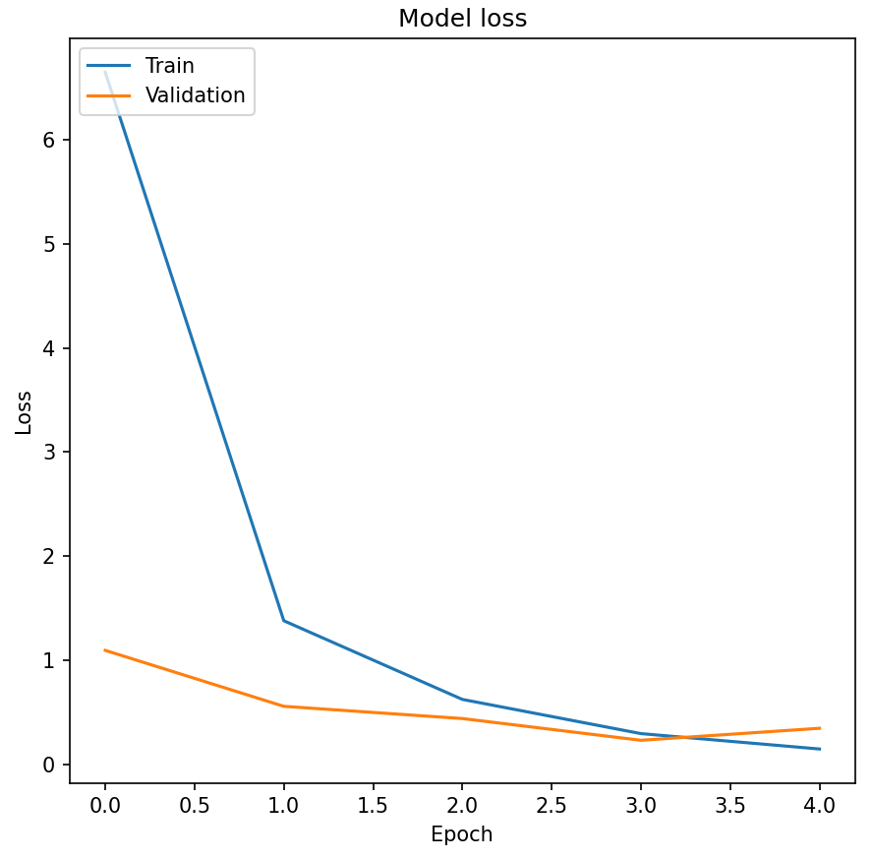
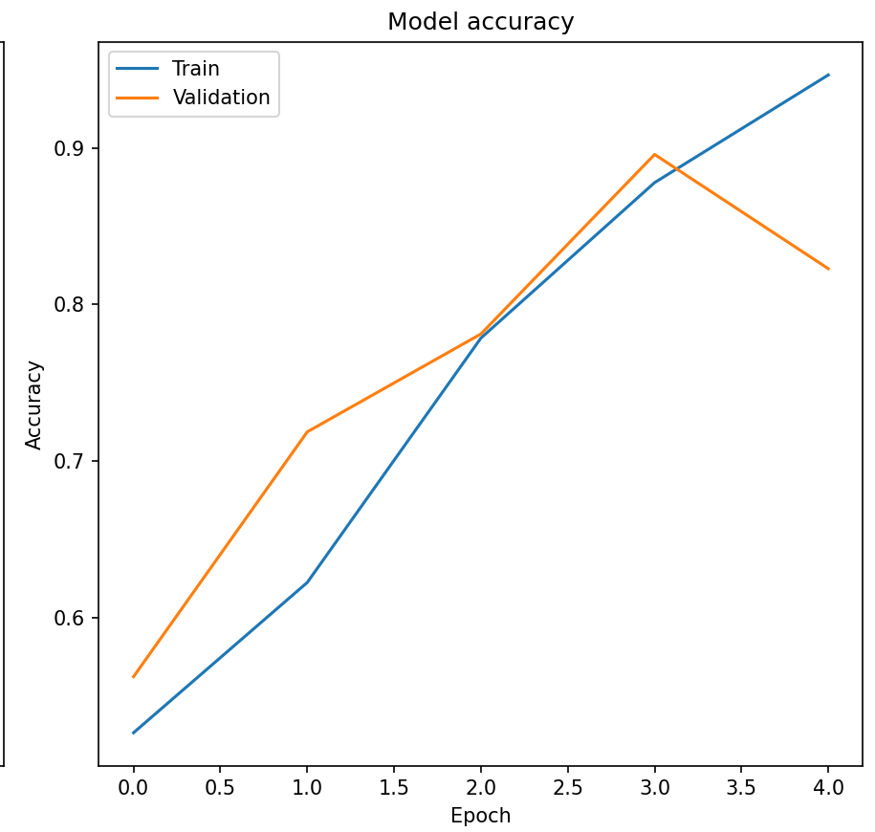
VGG16

Slide 31
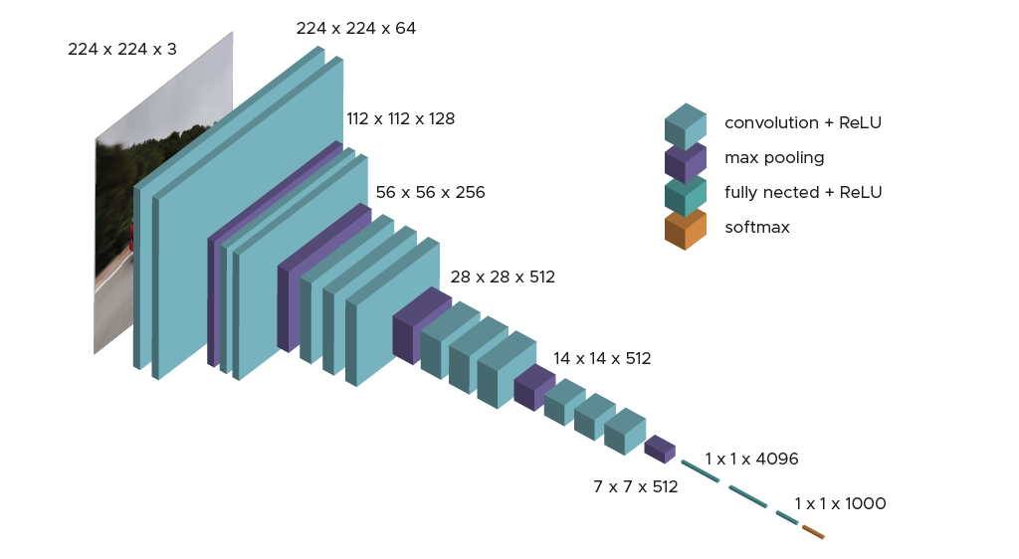
VGG16

Slide 32
RNN Model
model = Sequential([
SimpleRNN(64, input_shape=(X_train.shape[1], X_train.shape[2]), activation='relu'),
Flatten(),
Dense(3, activation='softmax') # Assuming 3 classes
])
# Compile the model
model.compile(optimizer='adam', loss='categorical_crossentropy', metrics=['accuracy'])

Slide 33
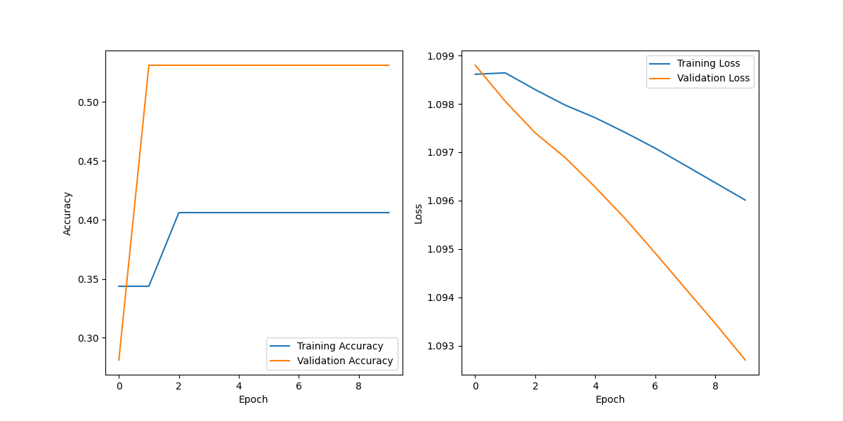
RNN Model

Slide 34
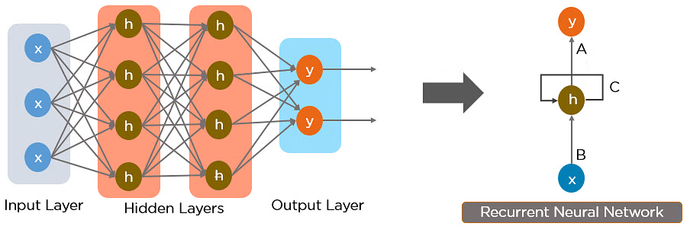
RNN Model

Slide 35
Autoencoder
def build_autoencoder(input_shape):
inputs = Input(shape=input_shape)
x = Conv2D(64, 3, activation='relu', padding='same')(inputs)
x = Conv2D(64, 3, activation='relu', padding='same')(x)
encoded = Conv2D(32, 3, activation='relu', padding='same')(x)
# Decoder
x = Conv2D(32, 3, activation='relu', padding='same')(encoded)
x = Conv2D(64, 3, activation='relu', padding='same')(x)
decoded = Conv2D(3, 3, activation='sigmoid', padding='same')(x)
# Output image has 3 channels (RGB)
model = Model(inputs, decoded)
return model

Slide 36
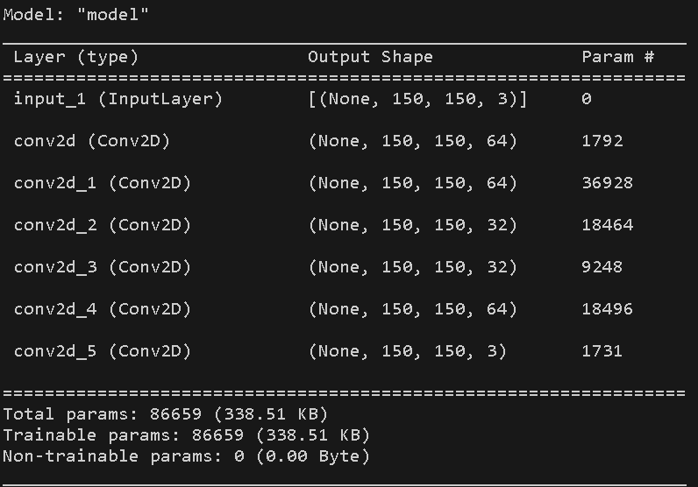
Autoencoder

Slide 37
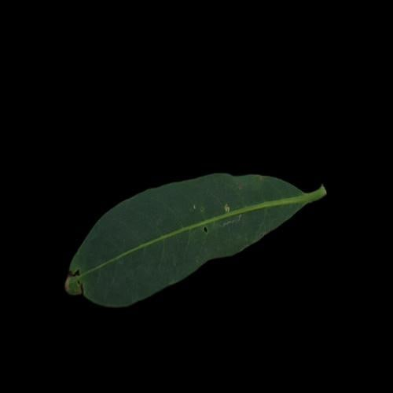
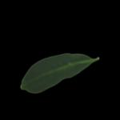
Autoencoder
Input
Output

Slide 38
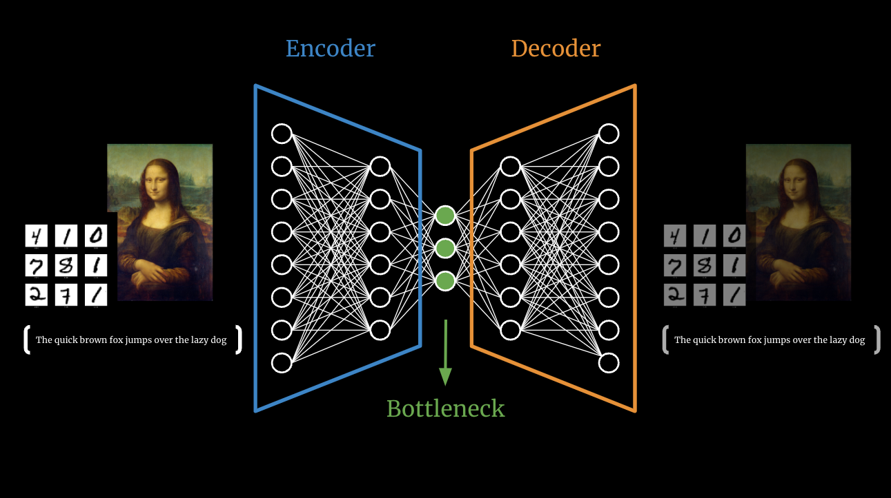
Autoencoder

Slide 39
Denoise autoencoder
def build_denoising_autoencoder(input_shape):
inputs = Input(shape=input_shape)
x = Conv2D(64, 3, activation='relu', padding='same')(inputs)
x = Conv2D(64, 3, activation='relu', padding='same')(x)
encoded = Conv2D(32, 3, activation='relu', padding='same')(x)
# Decoder
x = Conv2D(32, 3, activation='relu', padding='same')(encoded)
x = Conv2D(64, 3, activation='relu', padding='same')(x)
decoded = Conv2D(3, 3, activation='sigmoid', padding='same')(x)
# Output image has 3 channels (RGB)
model = Model(inputs, decoded)
return model

Slide 40
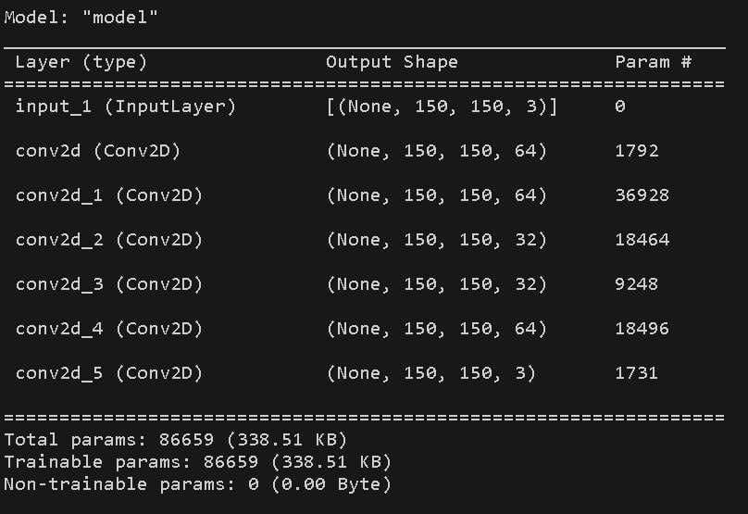
Denoise autoencoder

Slide 41
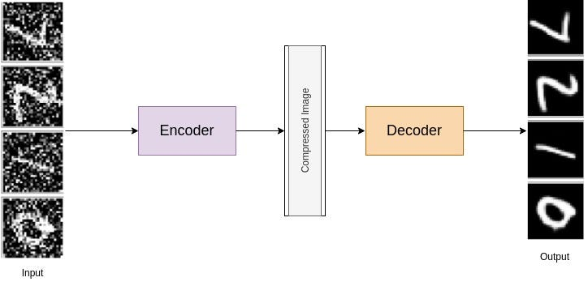
Denoise autoencoder

Slide 42
Autoenoder +Resnet
# Define ResNet block
def resnet_block(x, filters, kernel_size=3, strides=1):
y = Conv2D(filters, kernel_size=kernel_size, strides=strides, padding='same')(x)
y = BatchNormalization()(y)
y = Activation('relu')(y)
y = Conv2D(filters, kernel_size=kernel_size, strides=strides, padding='same')(y)
y = BatchNormalization()(y)
y = Add()([x, y])
y = Activation('relu')(y)
return y

Slide 43
Autoenoder +Resnet
# Build the autoencoder model
def build_autoencoder(input_shape):
inputs = Input(shape=input_shape)
x = Conv2D(64, 3, activation='relu', padding='same')(inputs)
x = resnet_block(x, 64)
x = resnet_block(x, 64)
x = Conv2D(3, 3, activation='sigmoid', padding='same')(x) # Output image has 3 channels (RGB)
# Decoder
y = Conv2DTranspose(64, 3, activation='relu', padding='same')(x)
y = resnet_block(y, 64)
y = resnet_block(y, 64)
outputs = Conv2DTranspose(3, 3, activation='sigmoid', padding='same')(y) # Output image has 3 channels (RGB)
model = Model(inputs, outputs)
return model

Slide 44
Thank you

